Slide 1
Rhino search challenge

Slide 2
Background
Ol Pejeta is home to the last two remaining northern white rhinos, and a sanctuary for over 165 critically endangered black rhinos.
The black rhinos need to be seen every 3 days.
If that’s not the case, search parties are sent out in the parc until they find the missing rhino.
Drones might be able to help this effort!

Slide 3
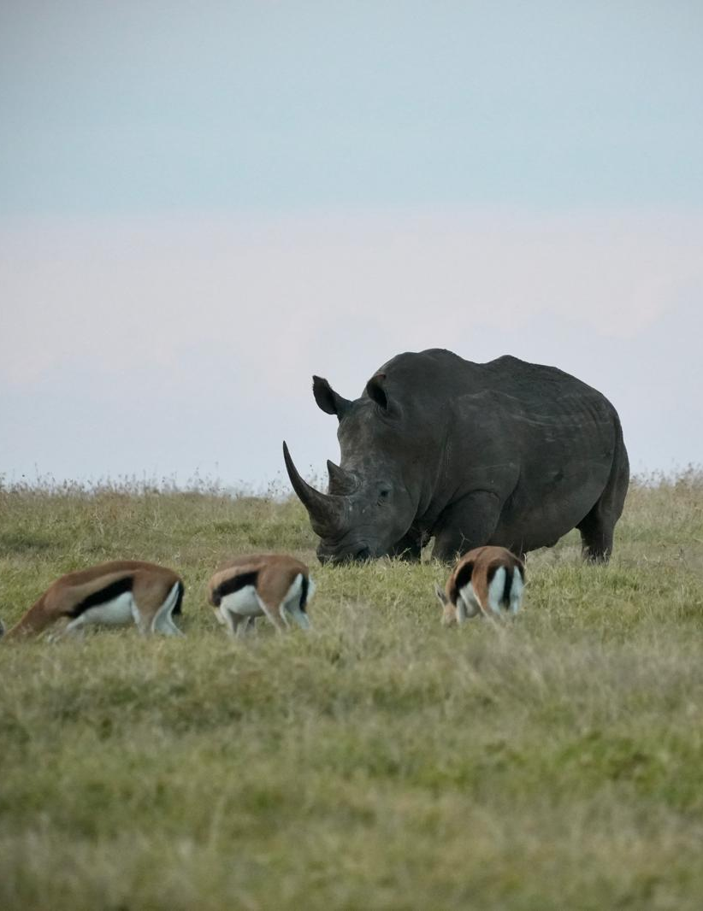
Rhino search challenge
Each team gets to control a drone in Ol Pejeta
The drone is equipped with a rhino range sensor and a downward-facing camera
The range sensor has a detection range of 200m.
The camera has a field of view of 50m on the ground.
Your goal is to find a strategy to find and take a picture of all the rhinos in the park.

Slide 4
Accessing the drone
Connect to local network
SSID: ANVLAN729
Password: ministrylevel369
Change connection to your groupe IP
Change the “target system” to your group ID

Slide 5
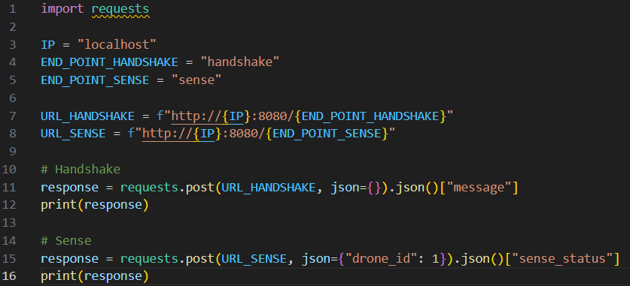
Accessing the sensor
Send a sense request to the sensor.
Returns
{"state": "out_of_range", "distance": -1}
{"state": "found", "distance": <dist>}
{"state": "in_range", "distance": <dist>}
Sensor characteristics
The range sensor has a detection range of 200m.
The camera has a field of view of 50m on the ground.

